Slide 1
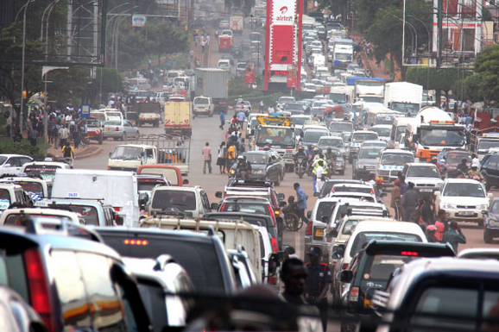
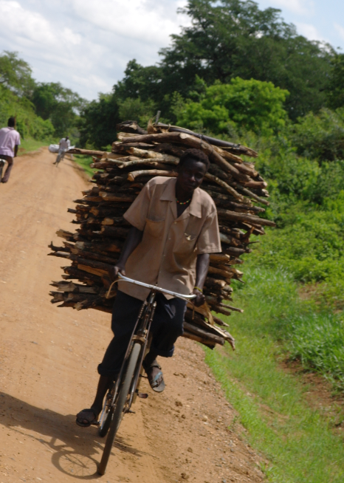
Megaproject Leadership: Organization & Performance
Nuno Gil
Professor of New Infrastructure Development
Manchester Business School
nuno.gil@mbs.ac.uk
Cairo, Egypt
© Nuno A. Gil. All Rights Reserved
Notes:
Like a kaleidoscope in which the view changes as it is rotated, any collaboration can be transformed as issues are addressed in this way

Slide 2
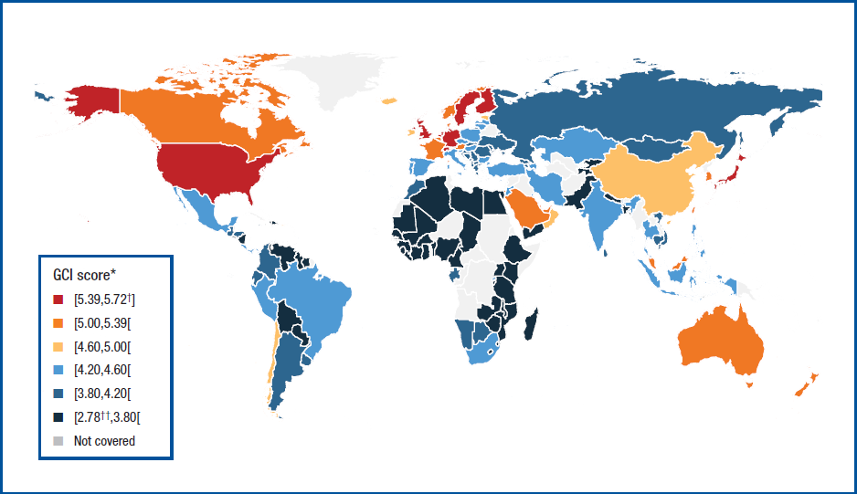
Megaproject: a form of organizing work to develop capital-intensive infrastructure
Infrastructure
-Man-made resource to share
-Backbone of modern society/pillar of economic competitiveness
-Major source of private and collective value creation
-Global problem: population growth, climate change, migration crisis
World Economic Forum’s Global Competitiveness Index 2012-2013
© Nuno A. Gil

Slide 3
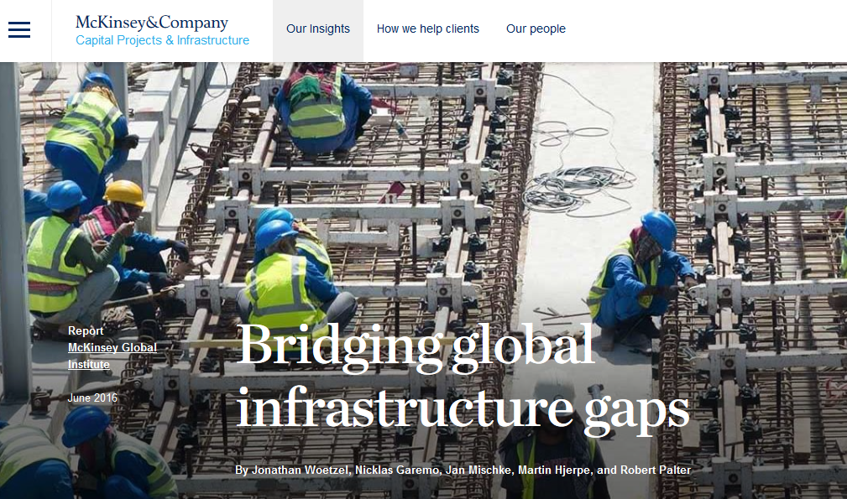
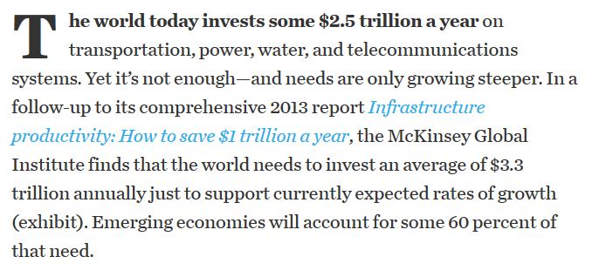

Slide 4
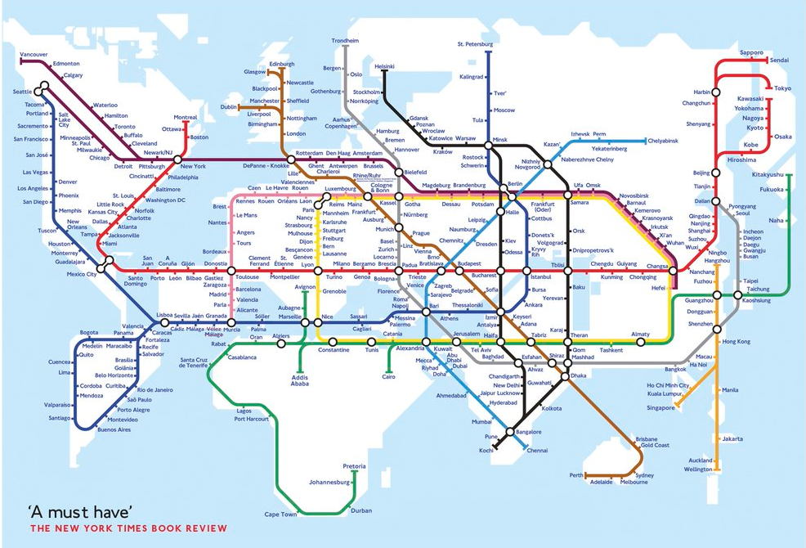

Slide 5
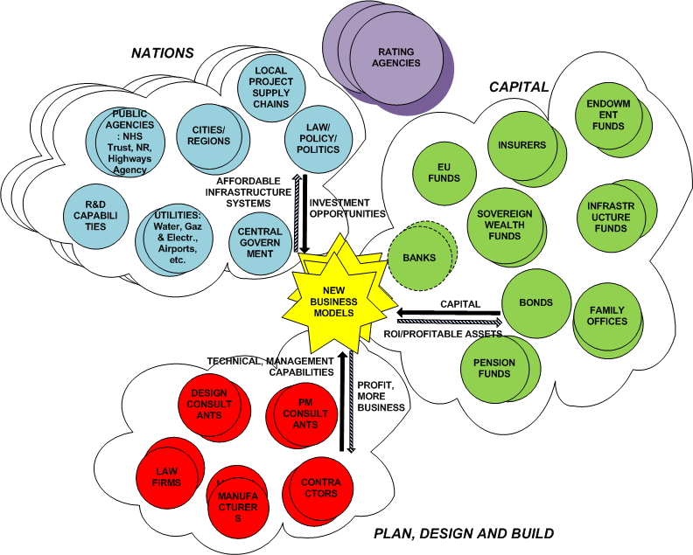
Infrastructure business ecosystem
© Nuno A. Gil
Notes:
This vision – THE INFRASTRUCUTRE BUSINESS ECOSYSTEM - is the golden thread in our proposal, and which drives our membership, and our proposed methods, and ultimately our outputs. THIS IS WHAT MAKES US DISTINCITVE. We introduce it in the proposal, and detailed it in the response to reviewers
Infrastructure Business Development is at the intersection of fundamentally different networks
A country itself is a network of complementors- planning, technology, law, local supply chains– we need to study their synergies and their role in developing robust business models

Slide 6
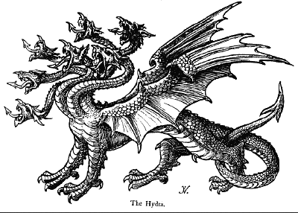
Prevailing Perception
© Nuno A. Gil

Slide 7
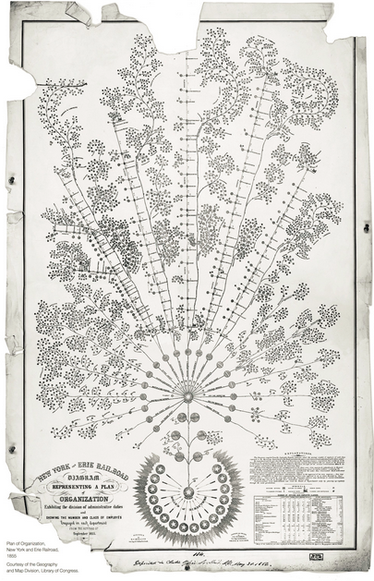
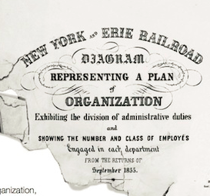
WORLD’S FIRST ORGANIZATIONAL MAP
Defines structure to help manage the New York and Erie Railwaoad system, (1855) by General Superintendent
©Nuno A. Gil, All rights reserved

Slide 8
WHAT IS A MEGAPROJECT?
CAPITAL-INTENSIVE PROJECT ORGANIZATIONS FORMED TO DEVELOP LARGE INFRASTRUCTURE
Transport systems (railways, highways, airports)
Energy systems (power plants, distribution networks)
Water and sewerage systems
Social assets (schools, hospitals)
Slum upgrades

Slide 9
WHY INFRASTRUCTURE MATTERS?
Global Competitive Index
Switzerland..#1 ……………..
Singapore # 2 ……………..
United States #3 ………………
Netherlands #4 ………………
Qatar #18 ………………
China #28 ………………
Saudi Arabia #29 ……………..
Kuwait 38 ……………..
India #39 ……………..
Morocco #70 ………………
Ethiopia #109 ……………….
Egypt #115 ………………
Nigeria #127 ………………
Infrastructure Quality
6
2
11
3
18
42
31
52
68
58
115
96
132
Population growth
Climate change
Globalization
WEF The Global Competitiveness Report 2016-2017
Nuno.gil@mbs.ac.uk © Nuno A. Gil. All Rights Reserved

Slide 10
INFRASTRUCTURE NATIONAL PLAN
Long-term framework that establishes national vision:
Transport systems
Energy systems
Water distribution
Sewerage
Harbours
Social assets: schools, hospitals
Slum upgrades
IDEA
Nuno.gil@mbs.ac.uk © Nuno A. Gil. All Rights Reserved

Slide 11
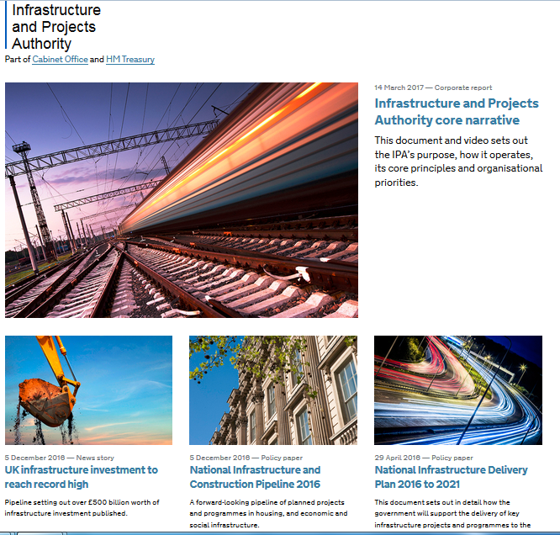
ESTABLISH THE INSTITUTIONS
Infrastructure Planning Commission (Independent)
Infrastructure and Projects Authority (with Treasury)
IDEA
Nuno.gil@mbs.ac.uk © Nuno A. Gil. All Rights Reserved

Slide 12
THREE FUNDAMENTAL PROBLEMS!
TECHNICAL
IDEA
POLITICAL
FINANCIAL
Nuno.gil@mbs.ac.uk © Nuno A. Gil. All Rights Reserved

Slide 13
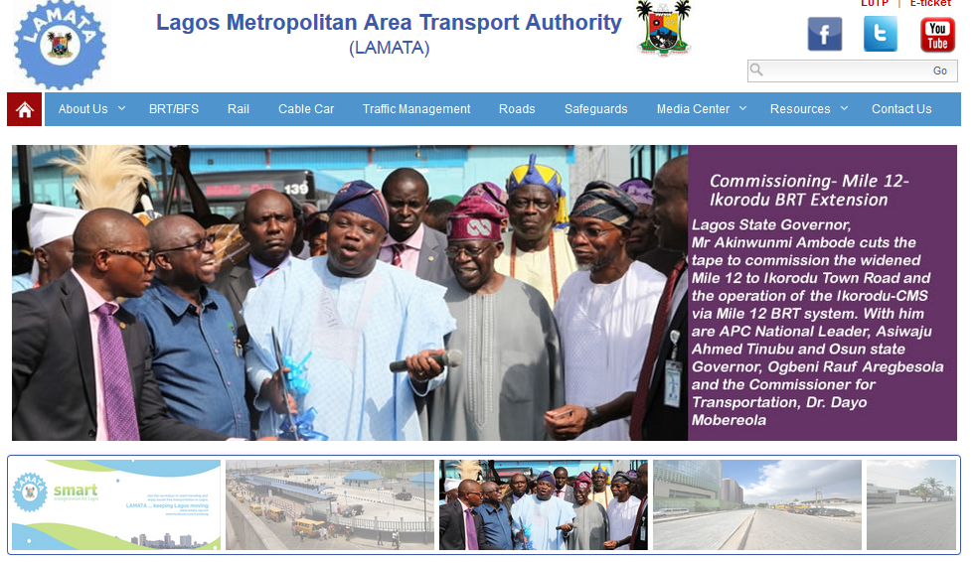
YOU NEED A UNIFYING SYSTEM GOAL!
idea that captures people’s imagination
IDEA
Nuno.gil@mbs.ac.uk © Nuno A. Gil. All Rights Reserved

Slide 14
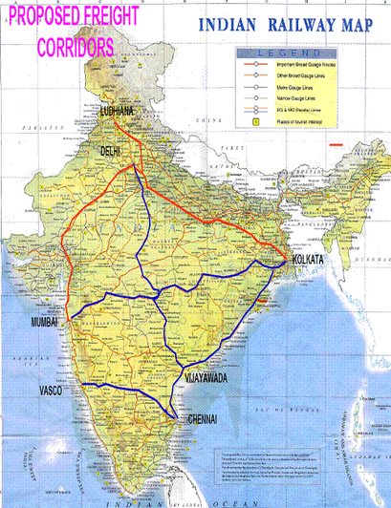
THINK ABOUT YOUR FUNDERS
Funders have wants, but also have constraints!
Align your idea with funders objectives
IDEA
Nuno.gil@mbs.ac.uk © Nuno A. Gil. All Rights Reserved

Slide 15
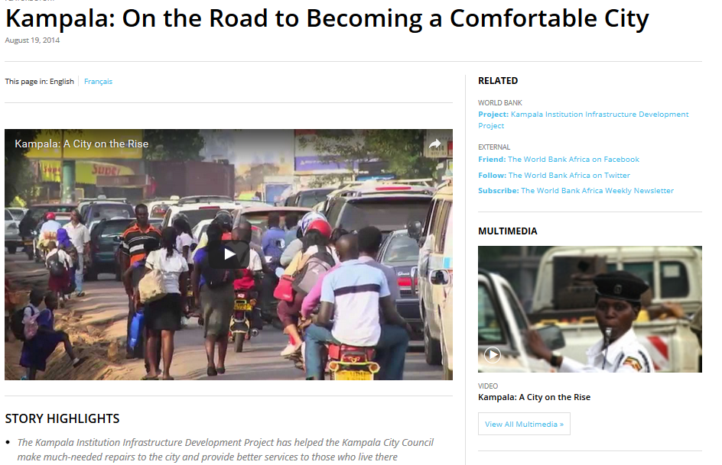
FIND MUTUALLY CONSENSUAL SOLUTIONS
‘We create our wants, in part, by experiencing our choices’
IDEA
Nuno.gil@mbs.ac.uk © Nuno A. Gil. All Rights Reserved

Slide 16
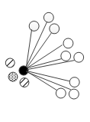
BE STRATEGIC
Who controls the critical resources? (land, finance, political support, knowledge of requirements)
Co-opt & adapt goal to carry along people you need
IDEA
Nuno.gil@mbs.ac.uk © Nuno A. Gil. All Rights Reserved

Slide 17
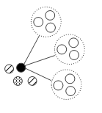
DESIGN THE PROJECT ORGANIZATION
Who are the supporters, opponents?
Which stakeholders you consult?
Which stakeholders must be development partners?
Set organizational boundaries: who does what?
IDEA
Nuno.gil@mbs.ac.uk © Nuno A. Gil. All Rights Reserved

Slide 18
COORDINATE
Technical people are good to set requirements, coordinate needs
IDEA
Nuno.gil@mbs.ac.uk © Nuno A. Gil. All Rights Reserved

Slide 19
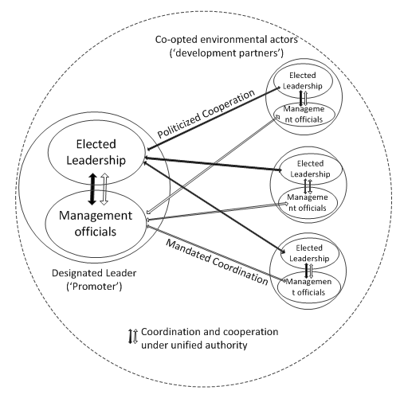
COOPERATE
Only leaders can negotiate/ cut deals
But leader need help from officials to see possible solutions
Nuno.gil@mbs.ac.uk © Nuno A. Gil. All Rights Reserved

Slide 20
MANAGE PERFORMANCE EXPECTATIONS
Performance targets (budgets, timescales, scope) give legitimacy to forge ahead
But it‘s hard to get the targets right early on
Build buffers
Be prepared to relax targets
IDEA
Nuno.gil@mbs.ac.uk © Nuno A. Gil. All Rights Reserved

Slide 21
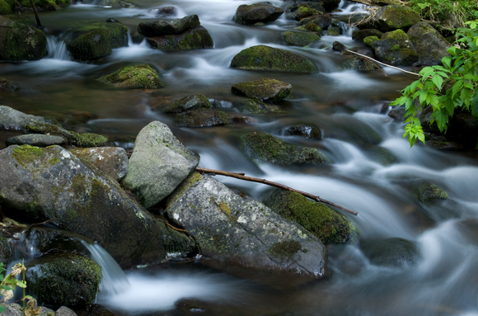
STAY OPTIMISTIC
It’s bloody hard work. But you must believe you can!
Be like water, flow around the rocks
Nuno.gil@mbs.ac.uk © Nuno A. Gil. All Rights Reserved

